Slide 1
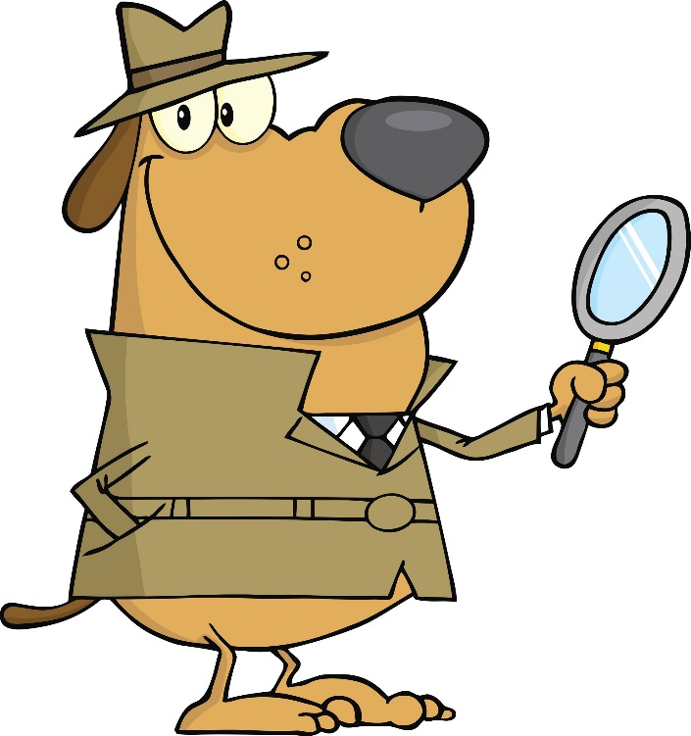
Qui suis-je?
What is your "best guess"?
A "best guess" is a guess that considers all the facts and that makes the most sense!
K Science: Questioning and Predicting
Students are expected to ask simple questions about familiar objects and events.

Slide 2
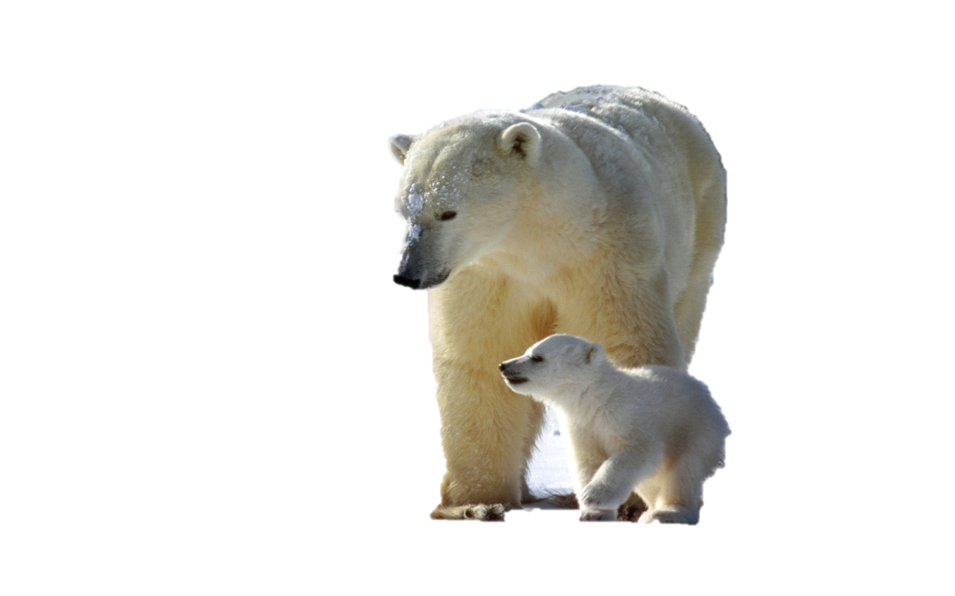
How big are my feet?
How do I walk?
What shape are my feet?

Slide 3
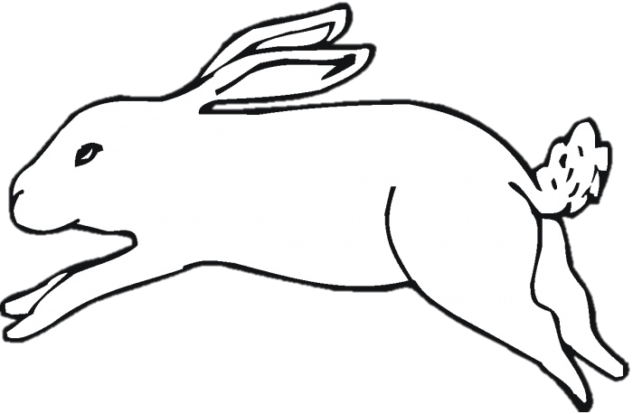
How big are my feet?
How do I walk?
What shape are my feet?

Slide 4
How big are my feet?
How do I walk?
What shape are my feet?

Slide 5
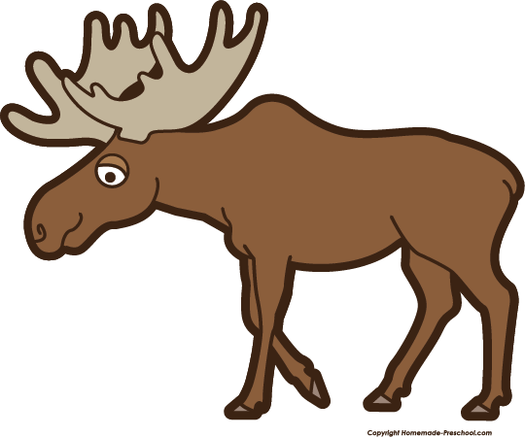
How big are my feet?
How do I walk?
What shape are my feet?

